Slide 1
CONTROLLED ACCESS
12-2
□In controlled access, the stations consult one another to find which station has the right to send.
□A station cannot send unless it has been authorized by other stations.
□Three controlled-access methods:
Reservation
Polling
Token passing

Slide 2
Reservation
In the reservation method, a station needs to make a reservation before sending data.
Time is divided into intervals.
In each interval, a reservation frame precedes the data frames sent in that interval.

Slide 3
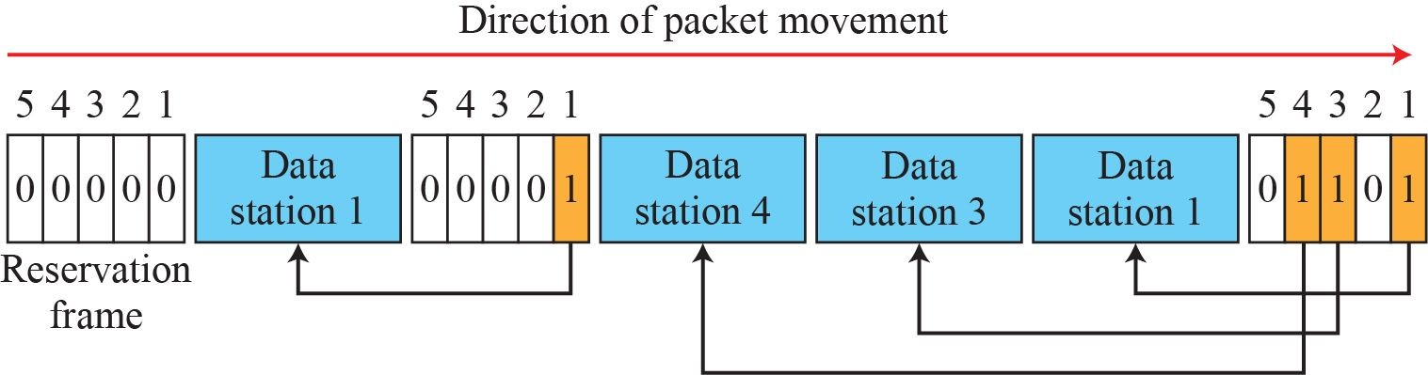
Reservation access method

Slide 4
Polling
□Polling works with topologies in which one device is designated as a primary station and the other devices are secondary stations.
□All data exchanges must be made through the primary device even when the ultimate destination is a secondary device.
□The primary device controls the link; the secondary devices follow its instructions.
□ It is up to the primary device to determine which device is allowed to use the channel at a given time.

Slide 5


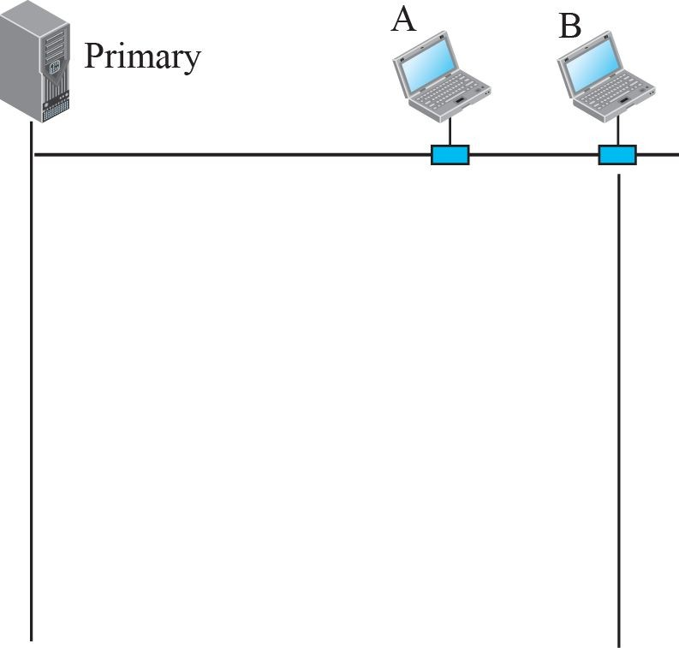
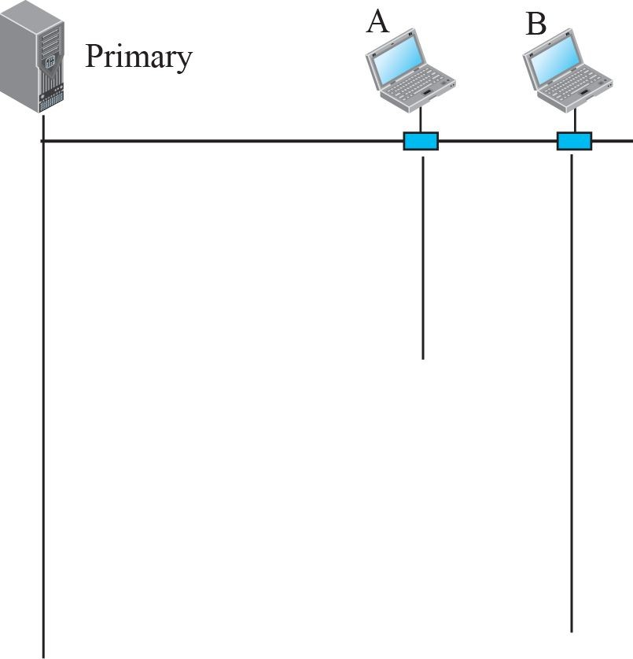





Select and poll functions in polling-access method

Slide 6
Polling
If primary wants to receive data, it asks the secondary's if they have anything to send.
This is called Polling.
If primary wants to send data, it tells the secondary to get ready to receive.
This is called Select function.

Slide 7
Token Passing
□In the token-passing method, the stations in a network are organized in a logical ring.
□ In other words, for each station, there is a predecessor and a successor.
□The predecessor is the station which is logically before the station in the ring;
□The successor is the station which is after the station in the ring.

Slide 8
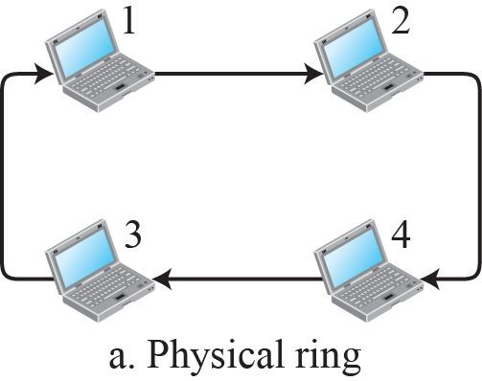
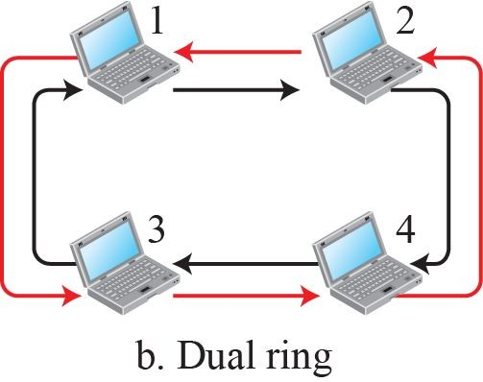
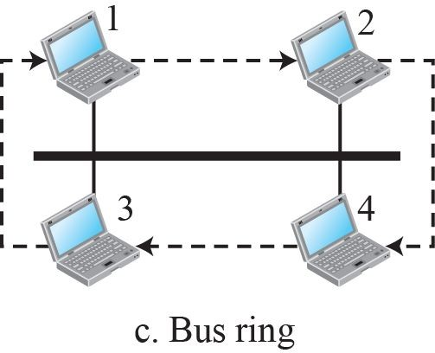
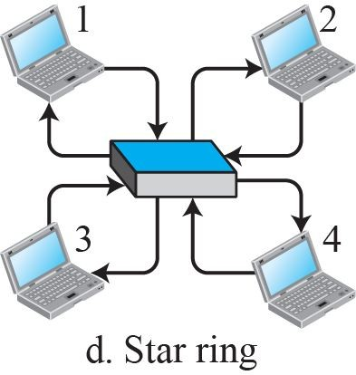
Logical ring and physical topology in token-passing
access method

Slide 9
12-3 CHANNELIZATION
□Channelization (or channel partition, as it is sometimes called) is a multiple-access
method in which the available bandwidth of a link is shared in time, frequency, or
through code, among different stations.
□Discuss three protocols:
□ FDMA, TDMA, and CDMA.

Slide 10
FDMA
□In frequency-division multiple access (FDMA), the available bandwidth is divided into frequency bands. Each station is allocated a band to send its data.
In other words, each band is reserved for a specific station, and it belongs to the station all the time.
□Each station also uses a bandpass filter to confine the transmitter frequencies.
To prevent station interferences, the allocates bands are separated from one another by guard bands.
FDMA specifies a predetermined frequency band for the entire period of communication

Slide 11
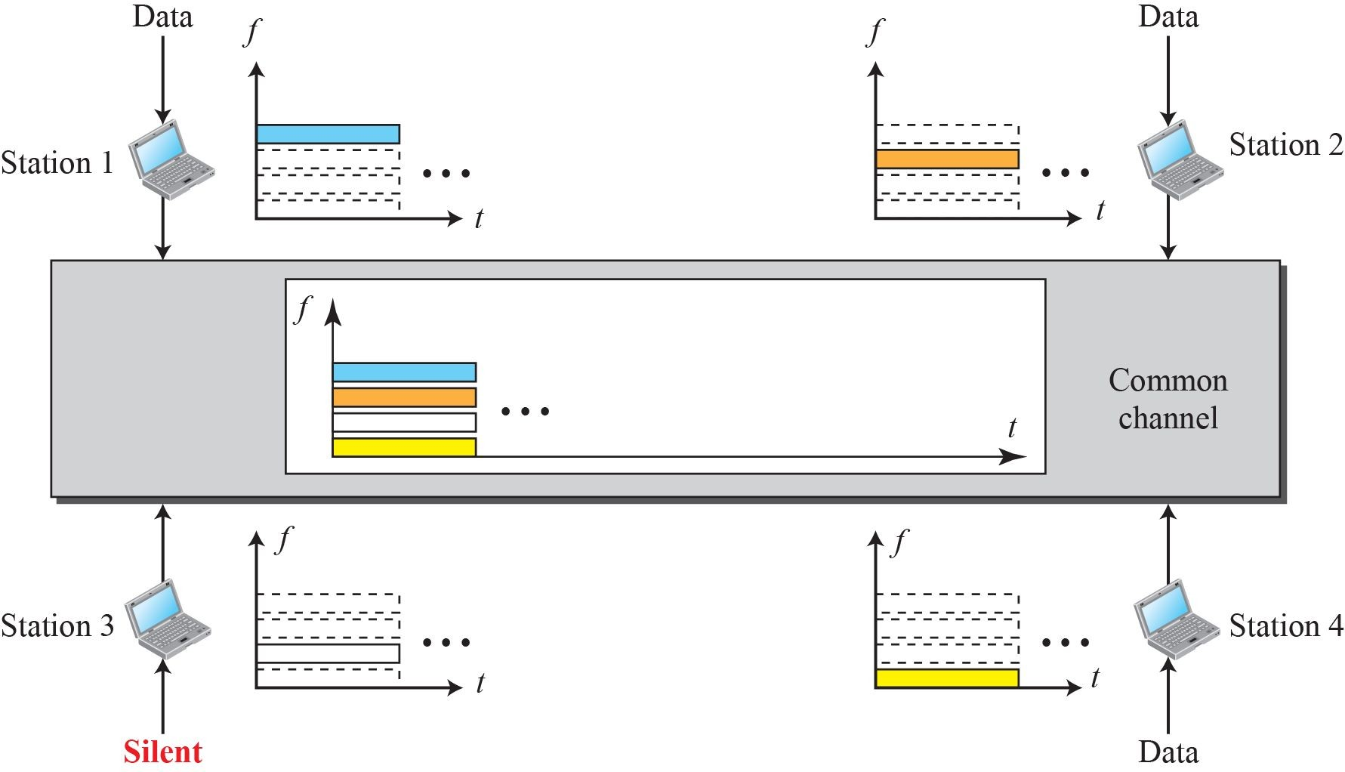
Frequency-division multiple access (FDMA)

Slide 12
FDMA
FDMA is access method in DLL.
DLL in each station tells the PL to make band pass signal from the data passed to it.
The signal must be created in the allocated band.
There is no physical multiplexer at the physical layer.
Signals created at each stations are automatically band pass filtered and mixed when they are sent to the common channel.

Slide 13
TDMA
□In time-division multiple access (TDMA), the stations share the bandwidth of the channel in time.
□ Each station is allocated a time slot during which it can send data.
Each station transmits its data in its assigned time slot.
□Main problem of TDMA lies in achieving synchronization between different stations.
□Each station needs to know beginning of its time slot and location of its slot.

Slide 14
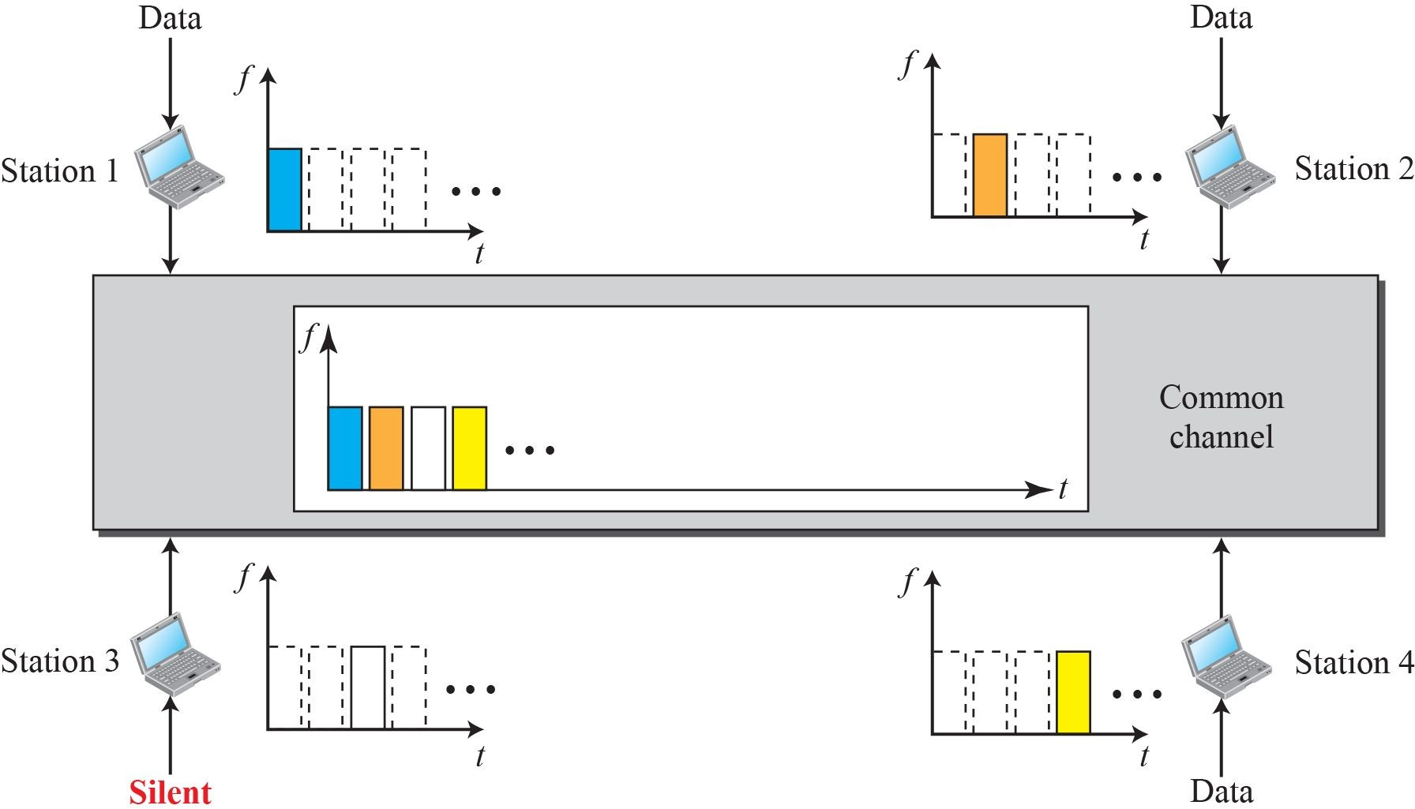
Time-division multiple access (TDMA)

Slide 15
TDMA
This may be difficult because of propagation delays introduced in the system if the stations are spread over a large area.
Synchronization is normally accomplished by having some synchronization bits at the beginning of each slot.
TDMA is an access method in DLL.
DLL in each station tells its physical layer to use allocated time slots.
There is no physical multiplexer at the physical layer.

Slide 16
CDMA
□Code-division multiple access (CDMA) was conceived several decades ago.
□Recent advances in electronic technology have finally made its implementation possible.
□CDMA differs from FDMA in that only one channel occupies the entire bandwidth of the link.
It differs from TDMA in that all stations can send data simultaneously; there is no timesharing.
Idea: Assume that there are 4 stations 1,2,3 and 4 connected to the same channel.
□The data from station1 are d1, station2 are d2, station 3 are d3
and station 4 are d4.
□ The code for station1 is C1, station2 is C2, station 3 is C3 and station 4 is C4.

Slide 17
CDMA
Assume that assigned codes have two properties 1)If we multiply each code by another, we get 0.
2) if we multiply each code by itself, we get 4.
Station 1 multiplies its data by its code to get d1.c1.
Station 2 multiplies its data by its code to get d2.c2.
Station 3 multiplies its data by its code to get d3.c3.
Station 4 multiplies its data by its code to get d4.c4.
The data that go on channel is sum of all these terms.
CDMA is based on coding theory.
Each station is assigned a code, which is a sequence of numbers called Chips.

Slide 18
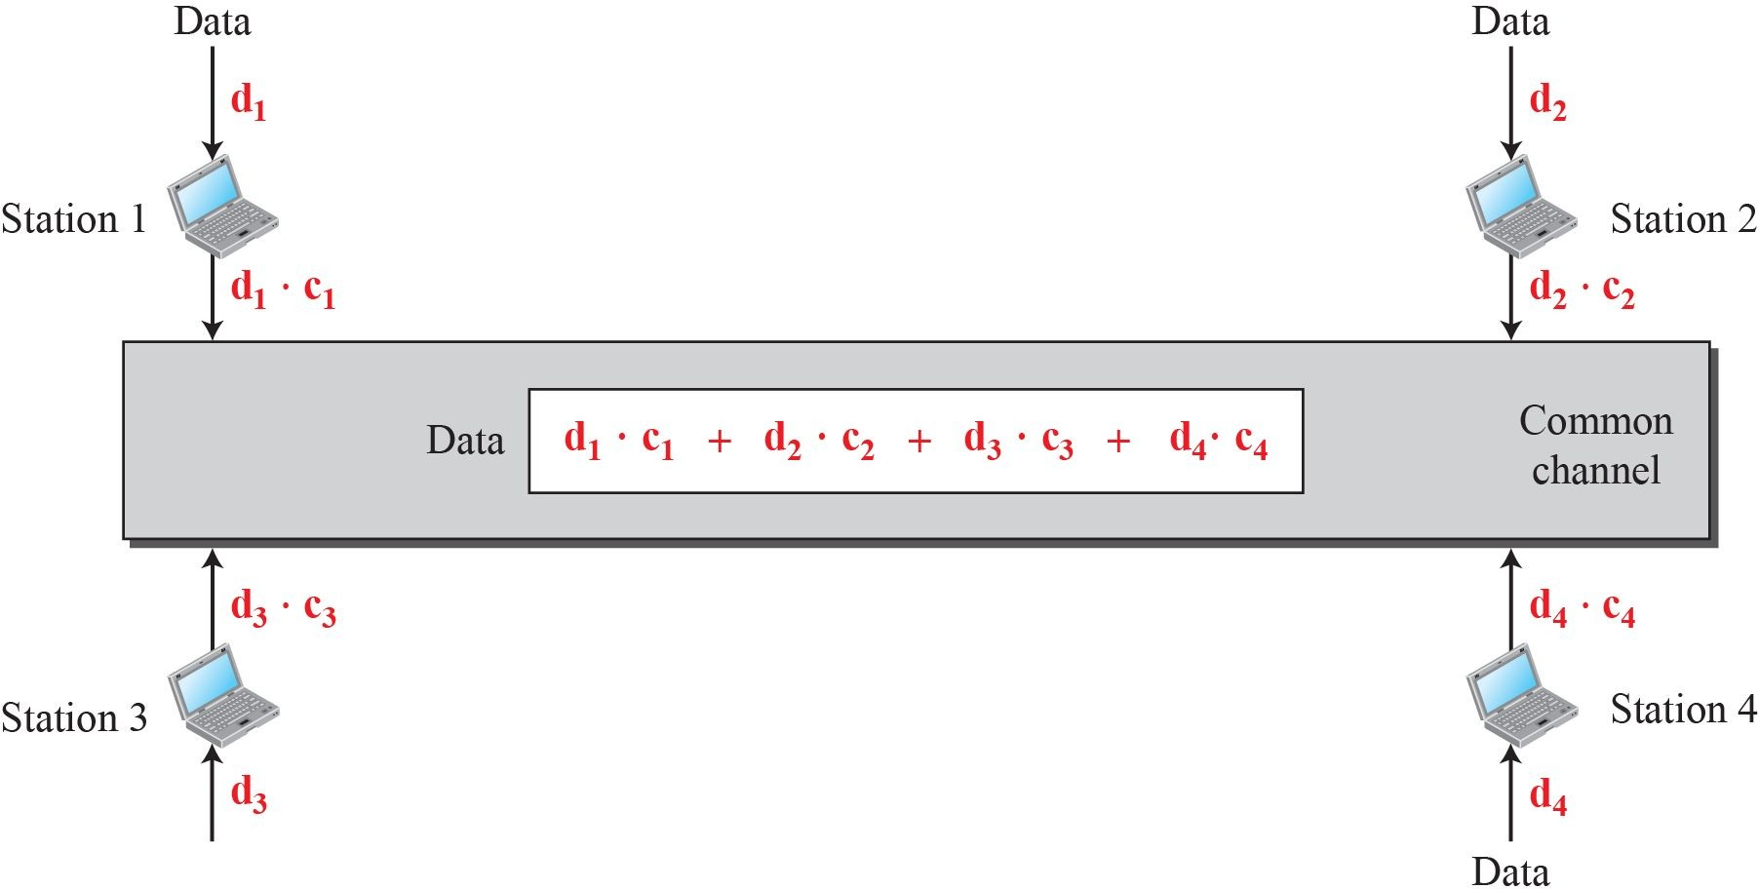
Simple idea of communication with code

Slide 19
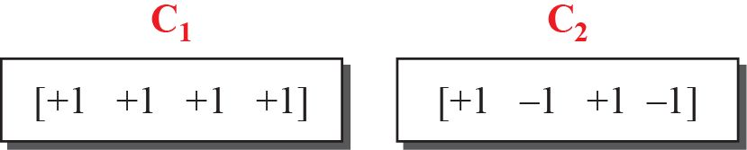
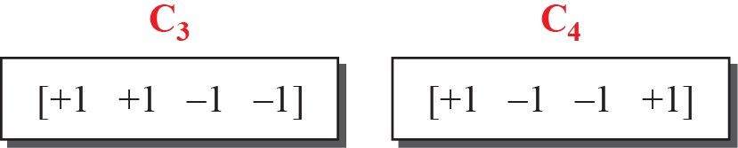
Chip sequences

Slide 20
Chips
Sequence is not choosen randomly.
They are called orthogonal sequences and have following properties.
Each sequence is made of N elements, where N is number of stations.
If we multiply a sequence by a number, every element in the sequence is multiplied by that number. This is called multiplication of a sequence by a scalar.
Eg: 2.[+1 +1 -1 -1] = [+2 +2 -2 -2]
If we multiply two same sequences element by element, and add the results, we get N. Where N is number of elements in each sequence. This is called Linear product of two equal sequences.

Slide 21
Chips
Eg: [+1 +1 -1 -1]. [+1 +1 -1 -1]= 1+1+1+1=4.
4). If we multiply two different sequences, element by element and add the results, we get 0.This is called inner product of two different sequences.
Eg: [+1 +1 -1 -1]. [+1 -1 -1+1]= +1-1+1-1=0
5) Adding two sequences means adding the corresponding elements. The result is another sequence.
Eg: [+1 +1 -1 -1]+ [+1 +1 -1 -1]= [+2+2 0 0]

Slide 22
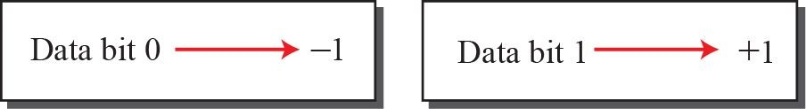
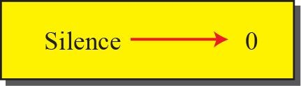
Data representation in CDMA

Slide 23
Data representation in CDMA
Follow the following rules for encoding.
If a station needs to send 0 bit, it encodes it as
-1, to send 1 bit, it encodes it as +1.
When station is idle, it sends no signal.

Slide 24
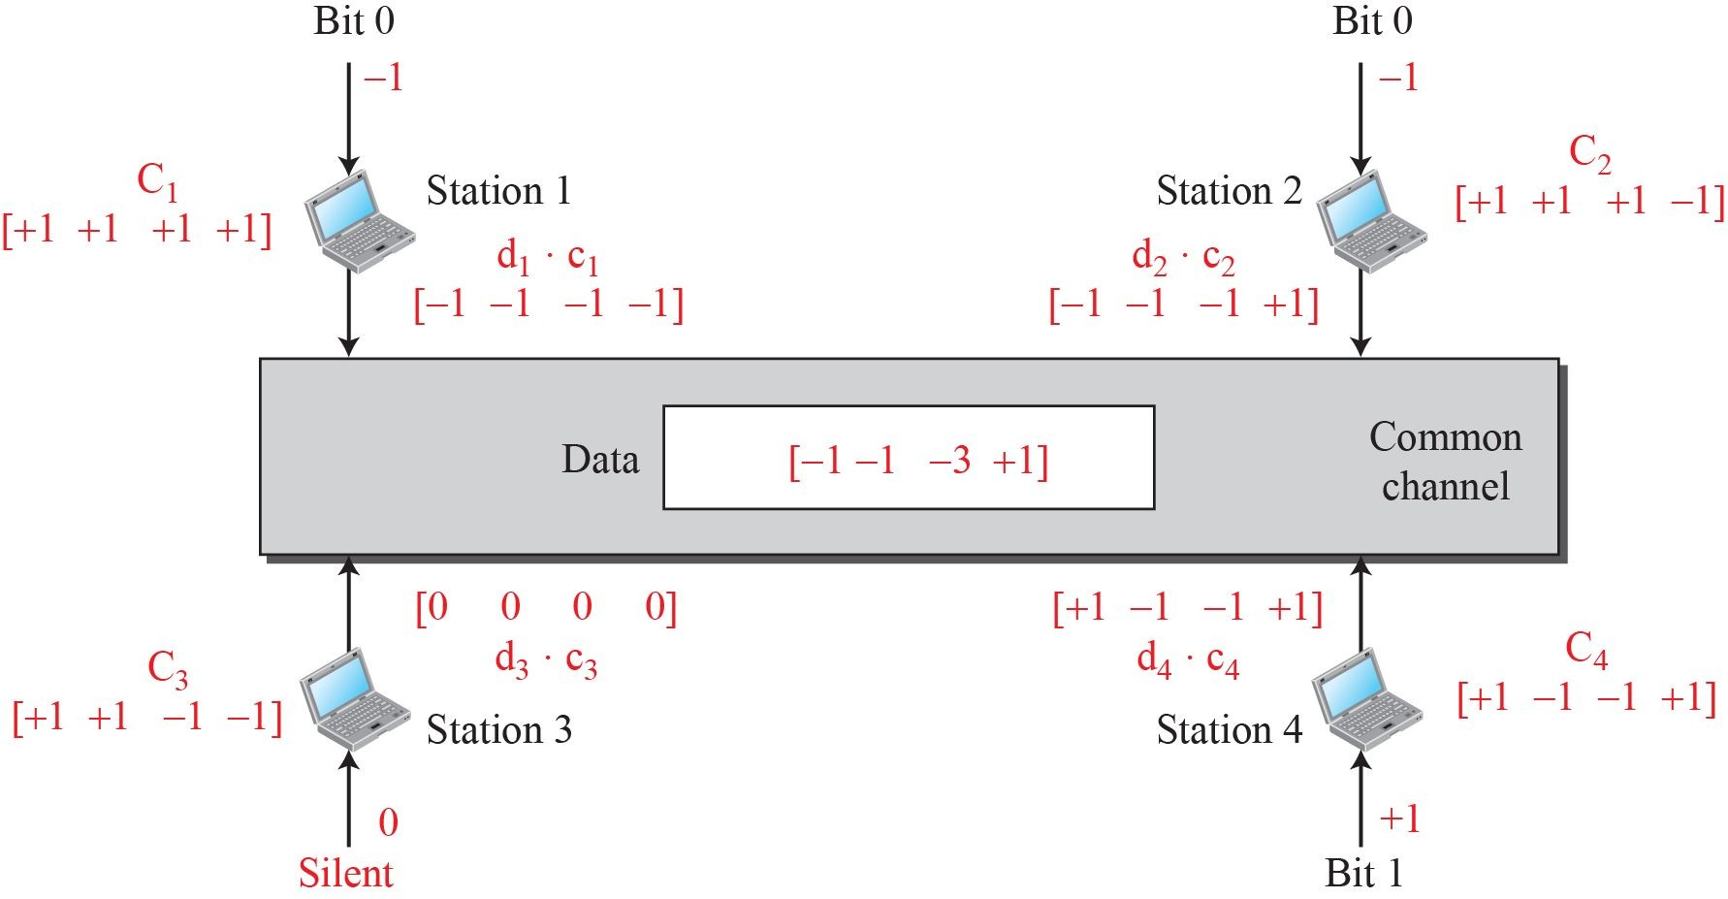
Sharing channel in CDMA

Slide 25
Encoding and decoding
Assume that stations 1 and 2 are sending a 0 bit, station 4 is sending 1 bit. Station 3 is silent.
The data at the sender site are translated to -1,-1,0 and +1.
Each station multiplies corresponding number by its chip, which is unique for each station.
The result is a new sequence which is sent to the channel.
We Assume that all stations send the resulting sequences at the same time.
The sequence on the channel is the sum of all four sequences.

Slide 26
Continued..
Imagine station 3, which is silent, listening to station 2.
Station 3 multiplies the total data on the channel by the code for station 2, which is [+1 -1 +1 -1], to get
[-1 -1 -3 +1[.[+1 -1 +1 -1]=-4/4=-1□bit 0.

Slide 27
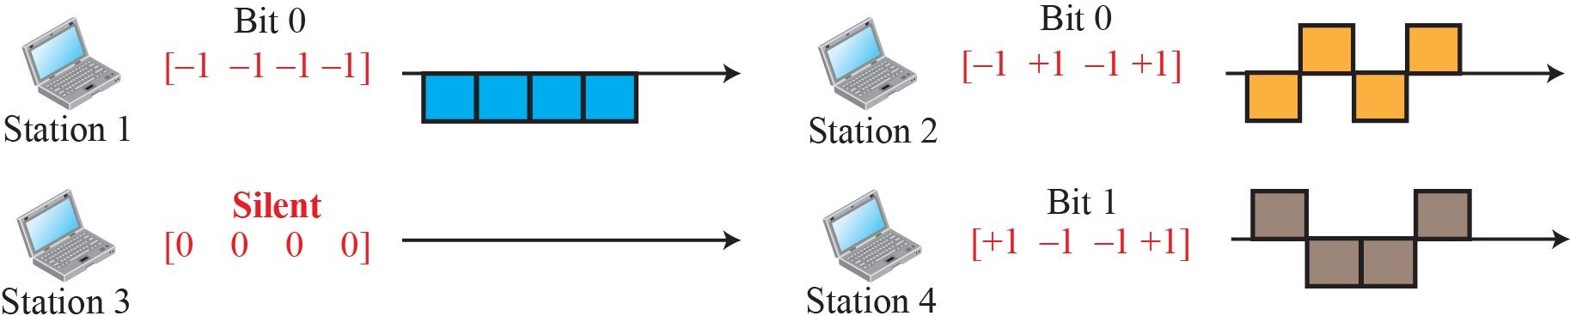
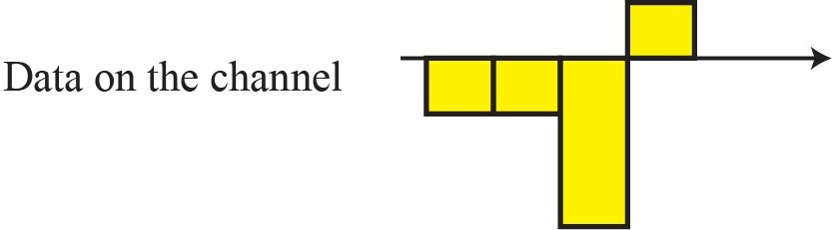
Digital signal created by four stations in CDMA

Slide 28
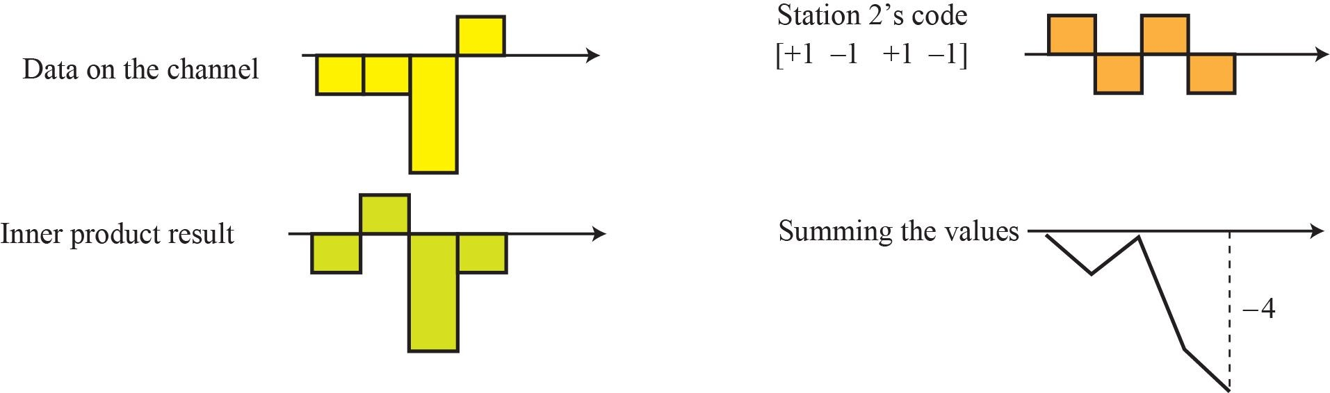
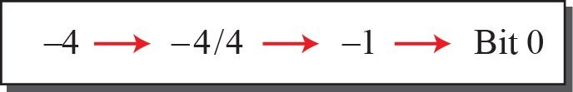
Decoding of the composite signal for one in CDMA

Slide 29
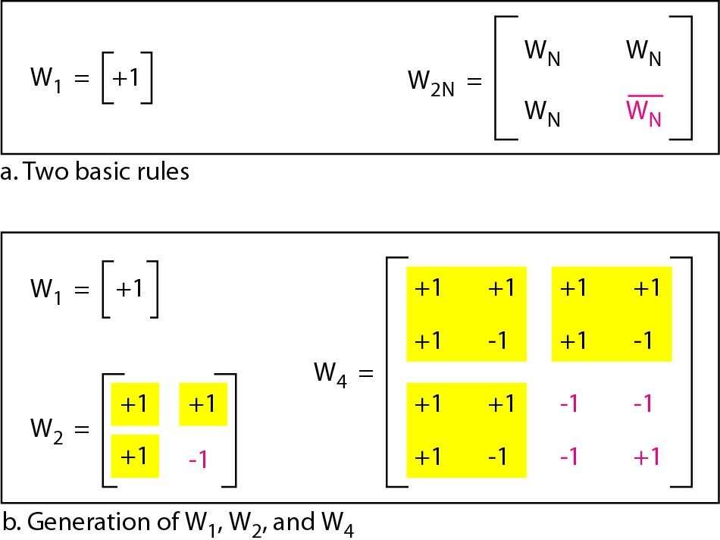
General rules and examples of creating Walsh tables
To generate chip sequences, walsh table is used which is a two dimensional table with an equal number of rows and columns.

Slide 30
Walsh table
In walsh table, each row is a sequence of chips.
W1 for a one-chip sequence has one row and one column.
We choose -1 or +1 for the chip.
According to Walsh, if we know the table for N sequences Wn, we can create a table for 2N sequences W2n.
The number of sequences in a Walsh table needs to be N = 2^{m}.

